Slide 1
An Inside Look at the Nuanced Art of Large-Scale, Interdisciplinary Ideation
Miranda Mattingly, Ph.D.
Associate Director, Strategic Initiatives
USF Research Development Institute
4.28.2025

Slide 2
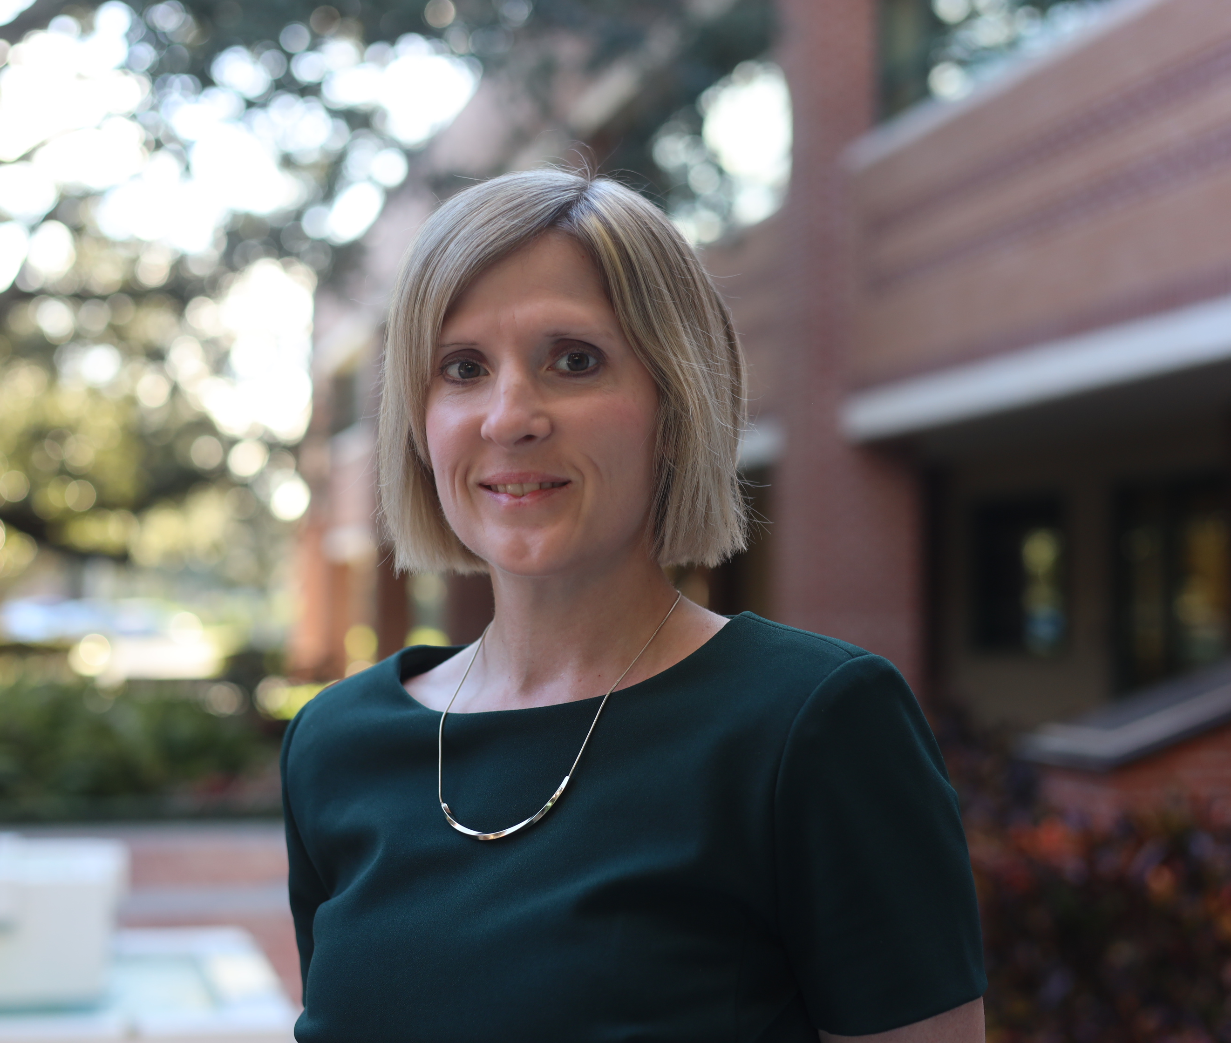
Miranda Mattingly, Ph.D.
Associate Director of Strategic Initiatives, USF Development Institute (Current)
Assistant Director, Foundation Relations, USF Foundation
Office Director, Office of Writing Instruction, Walden University
Faculty, English and Writing Instruction, Various Institutions

Slide 3
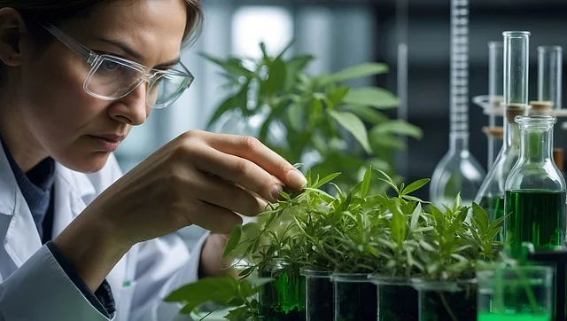




Context: USF Think Tank Initiative
Vision: Cultivate dynamic, collaborative research environments where the expertise of interdisciplinary and transdisciplinary teams converge to co-create bold solutions to complex societal challenges, and catalyze the building of robust research ecosystems around them to accelerate the translation of research into real-world, community impact.
Future of Food
Future of Education
Health & Technology
Oceans of Data
AI & Cybersecurity

Slide 4

Points of Emphasis
USF Think Tanks
Organic, faculty & community-led approach
Added emphasis on transdisciplinary research and the co-creation of knowledge
Focused on building robust research ecosystems around teams or a multitude of teams rather than catalyzing the formation of teams alone.
Opportunity to experiment with variety of ideation session types.

Slide 5
Purpose
This breakout session aims to equips RD professionals with tools and knowledge to facilitate large-scale, interdisciplinary ideation sessions through exploration of different model types. Through shared experiences, we will learn to adapt and refine ideation approaches to fit need, while fostering discoveries and transformative solutions to grand challenges.

Slide 6
Defining Our Scope
A large-scale funding opportunity typically refers to substantial financial support provided by government agencies, private foundations, or other organizations to fund multi-year projects or initiatives that address major societal challenges, stimulate economic growth, or advance scientific research and innovation.
Often framed as bold/grand challenges
Pave the way for a new technology, field, or industry to emerge
Emphasis on interdisciplinary or transdisciplinary research or multi-institutional support
Require long-term planning
Preliminary findings complete with scalable model designed
Articulated vision for innovation & broader impacts

Slide 7
Where Do You Start?
Let’s Talk about Pre-Pre Award

Slide 8
Defining Our Scope
The pre-pre award stage involves the initial ideation, planning, and preparation for a research project before formal proposal development begins.
Ideation sessions
Problem & possible solutions definition
Team formation
Vision & project conceptualization
Strategic planning
  Proposal planning
  Funding identification
  Resource assessment
  Preliminary data collection identification
  Key stakeholder identification

Slide 9

What’s Their Purpose?
Ideation Sessions
Generate innovative ideas
Foster collaboration
Identify opportunities & improvements
Solve problems
Set a direction
Build consensus
Enhance engagement
Notes:
Generate Innovative Ideas
Encourage creative thinking and brainstorming to produce new and unique solutions.
Foster Collaboration
Help faculty identify collaborators & promote teamwork and interdisciplinary collaboration to leverage diverse perspectives.
Identify Opportunities & Improvements
Explore potential areas for development and improvement within a challenge.
Solve Problems
Address complex issues by combining insights from various disciplines and stakeholders.
Set Direction
Define clear objectives and strategies for moving forward with the proposed ideas.
Build Consensus
Facilitate discussions to reach a common understanding and agreement on the best approaches.
Enhance Engagement
Engage participation from areas not always associated with project or problem.

Slide 10

Types of Ideation Sessions

Slide 11
Funding Launch Model
Present a single or a few large-scale funding opportunities relevant to a general area of research.
Provide details on focus areas, eligibility criteria, & application process.
Use breakout groups to explore focus areas & identify novel approaches.
Have groups outline both institutional strengths and capacity building efforts (e.g., preliminary findings, resources, desired expertise or collaborators) needed to pursue competitive proposal.
Reconvene, share findings & summarize key takeaways.
Objective: Discuss strategies to collectively build capacity to pursue identified funding opportunity or opportunities within a larger area of research.

Slide 12
Outcomes
Funding Launch Model
Clear understanding of key, large-scale funding opportunities relevant to the research area.
Development of actionable strategies for building institutional capacity & competitive proposals for identified funding opportunities.
Generation of novel ideas and approaches for addressing the focus areas of the funding opportunities.
Acceleration of team formation around interdisciplinary areas of research.

Slide 13
Ignite Model
Faculty present short lightning talks of their work.
Discuss intersections with presented ideas.
Small groups brainstorm collaborative research projects or initiatives.
  Identify key research questions.
  Propose collaborative approaches.
  Outline potential impacts and outcomes.
Reconvene, present their ideas, & discuss next steps for each proposed project.
Summarize key takeaways from the session.
Objective: Rapidly generate and share innovative ideas on a specific topic through short, focused presentations and collaborative discussions.

Slide 14
Outcomes
Ignite
Model
Immediate acceleration of faculty research projects.
Opportunity to create new or expand team formation.
Enrichment of research methodologies and access to shared resources.
Actionable research projects ready for collaborative implementation.
Notes:
Generate Innovative Ideas
Encourage creative thinking and brainstorming to produce new and unique solutions.
Foster Collaboration
Help faculty identify collaborators & promote teamwork and interdisciplinary collaboration to leverage diverse perspectives.
Identify Opportunities & Improvements
Explore potential areas for development and improvement within a challenge.
Solve Problems
Address complex issues by combining insights from various disciplines and stakeholders.
Set Direction
Define clear objectives and strategies for moving forward with the proposed ideas.
Build Consensus
Facilitate discussions to reach a common understanding and agreement on the best approaches.
Enhance Engagement
Engage participation from areas not always associated with project or problem.

Slide 15
Pre-circulate research report for review.
Have a panel briefly summarize the report’s key findings, implications & areas for further research.
Quickfire discussion of responses & immediate opportunities for collaboration.
Use breakout groups to:
  Propose collaborative approaches.
  Identify institutional or cross-disciplinary strengths.
  Outline research questions & potential methods, impacts and outcomes.
Reconvene & present ideas.
Summarize key takeaways from the session.
Report & Response Model
Objective: Use established research report or publication to generate quickfire responses, identify areas of institutional strengths, & brainstorm innovative ideas for advancing the field of research.

Slide 16
Outcomes
Report & Response Model
A set of actionable responses and innovative ideas for advancing interdisciplinary fields of research.
Enhanced interdisciplinary connections among participants.
A roadmap for implementing the best ideas generated during the session.
Notes:
Generate Innovative Ideas
Encourage creative thinking and brainstorming to produce new and unique solutions.
Foster Collaboration
Help faculty identify collaborators & promote teamwork and interdisciplinary collaboration to leverage diverse perspectives.
Identify Opportunities & Improvements
Explore potential areas for development and improvement within a challenge.
Solve Problems
Address complex issues by combining insights from various disciplines and stakeholders.
Set Direction
Define clear objectives and strategies for moving forward with the proposed ideas.
Build Consensus
Facilitate discussions to reach a common understanding and agreement on the best approaches.
Enhance Engagement
Engage participation from areas not always associated with project or problem.

Slide 17
World Café Model
Use previous ideation session model (e.g., funding, ignite, or report & response) to frame discussion around an area of emerging research or societal challenge.
Use breakout groups to brainstorm solutions for designated challenge or research topic.
Have groups rotate, building on the ideas presented by the previous group & adding new insights.
Rotate until original group is back & can review recommendations.
Present findings.
Open conversation to networking & team formation.
Objective: Collaboratively brainstorm and refine solutions for an emerging research topic or societal challenge through dynamic group rotations and discussions.

Slide 18
Outcomes
World Café Model
Development of a shared understanding of the challenge or research topic.
Refinement of ideas through collaborative discussions and group rotations.
Creation of detailed action plans for implementing the proposed solutions.
Identification of potential collaborators and team members.
Notes:
Generate Innovative Ideas
Encourage creative thinking and brainstorming to produce new and unique solutions.
Foster Collaboration
Help faculty identify collaborators & promote teamwork and interdisciplinary collaboration to leverage diverse perspectives.
Identify Opportunities & Improvements
Explore potential areas for development and improvement within a challenge.
Solve Problems
Address complex issues by combining insights from various disciplines and stakeholders.
Set Direction
Define clear objectives and strategies for moving forward with the proposed ideas.
Build Consensus
Facilitate discussions to reach a common understanding and agreement on the best approaches.
Enhance Engagement
Engage participation from areas not always associated with project or problem.

Slide 19
Vision Focused Model
Share tentative vision statement for a collaborative research project or collaborative research team/network, detailing:
  the challenge being addressed & possible solutions,
  areas for collaborations,
  expertise and resources needs, and
  desired outcomes.
Discuss statement & allow for immediate revisions.
Use breakout groups to refine areas of statement into next step action plans.
Reconvene, share findings & summarize key takeaways.
Objective: Use a tentative vision statement for a collaborative research project or network to create a shared understanding of its goals, priorities, and the innovative approaches needed to achieve impactful outcomes.

Slide 20
Outcomes
Vision Focused Model
Develop a clear, unified understanding of the project, team, or network's goals & priorities.
Enhanced commitment to the vision among all members.
Strengthened interdisciplinary connections, teamwork and network-building.
Collaboratively developed strategic plan for development.
Notes:
Generate Innovative Ideas
Encourage creative thinking and brainstorming to produce new and unique solutions.
Foster Collaboration
Help faculty identify collaborators & promote teamwork and interdisciplinary collaboration to leverage diverse perspectives.
Identify Opportunities & Improvements
Explore potential areas for development and improvement within a challenge.
Solve Problems
Address complex issues by combining insights from various disciplines and stakeholders.
Set Direction
Define clear objectives and strategies for moving forward with the proposed ideas.
Build Consensus
Facilitate discussions to reach a common understanding and agreement on the best approaches.
Enhance Engagement
Engage participation from areas not always associated with project or problem.

Slide 21
Pollinator Pairings Model
Explain pollinator pairing concept (i.e., how different disciplines can complement each other).
Identify challenge, solution, or topic for collaboration.
Pairs discuss how their disciplines can work together (e.g., explore integrated methodologies; identify strengths & weaknesses in pairing).
Present findings.
Open conversation to additional pairings (i.e., collaborators).
Create space for networking and team formation.
Objective: Use dynamic matching or pairing exercise to identify challenges to interdisciplinary collaboration, explore integrated methodologies, and leverage complementary strengths to developing innovative solutions, culminating in team formation.

Slide 22
Outcomes
Pollinator Pairing Model
Hands-on recognition of the importance of interdisciplinary collaboration to solving complex problems.
Practical opportunity to discuss and map pathway for integrated research methodologies.
Pinpoint barriers to collaboration and identify solutions to overcome challenges.
Acceleration of team formation around interdisciplinary areas of research.
Notes:
Generate Innovative Ideas
Encourage creative thinking and brainstorming to produce new and unique solutions.
Foster Collaboration
Help faculty identify collaborators & promote teamwork and interdisciplinary collaboration to leverage diverse perspectives.
Identify Opportunities & Improvements
Explore potential areas for development and improvement within a challenge.
Solve Problems
Address complex issues by combining insights from various disciplines and stakeholders.
Set Direction
Define clear objectives and strategies for moving forward with the proposed ideas.
Build Consensus
Facilitate discussions to reach a common understanding and agreement on the best approaches.
Enhance Engagement
Engage participation from areas not always associated with project or problem.

Slide 23
Breakout Groups Instructions
Breakout rooms for each ideation session type.
Choose a model and join room to take deeper dive into building a framework for this ideation session.
Have the opportunity to build this framework with peers and discuss potential challenges and considerations.
Or use the attached template to brainstorm on your own.
Either way, we’ll come back together to discuss our findings as a collective group.

Slide 24
Breakout Rooms
Breakout Room 1 – Funding Launch Model
Breakout Room 2 – Ignite Model
Breakout Room 3 – Report & Response Model
Breakout Room 4 – World Café Model
Breakout Room 5 – Vision Focused Model
Breakout Room 6 – Pollinator Pairing Model

Slide 25
Discussion
What ideation model resonated with you and why? If you have past experience, what made the session successful or challenging?
What modifications would you need to make to your chosen model for implementation?
How will you frame and position this session to keep groups accountable? How would you encourage participants to think beyond traditional boundaries or encourage engagement throughout this ideation session?
What tools might you need, or have you found are most useful in accelerating the success of these types of large-scale ideation sessions?

Slide 26

Miranda Mattingly, Ph.D.
Contact Info
Associate Director, Strategic Initiatives
Research Development Institute
University of South Florida
mattinglym@usf.edu
usf.edu/rdi

Slide 27
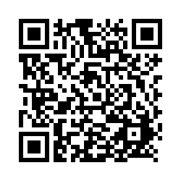
Please remember to fill out the feedback survey.
Notes:
https://usf.az1.qualtrics.com/jfe/form/SV_3Q63hK52d4Wlr9Q

Slide 28

Thank You

